Slide 1
Strategies for Proactive Revenue Cycle Management
David Brewer, Revenue Cycle Director, Allscripts

Slide 2
David Brewer REVENUE CYCLE DIRECTOR, ALLSCRIPTS
Consults with Allscripts clients to discuss their revenue cycle performance
25 years of experience in revenue cycle management, practice management and hospital management
Maximizes client results with a variety of revenue cycle solutions
Passionate about using technology to reduce redundancy and increase visibility into performance

Slide 3
Which of the following best represents your role in your organization?
Polling question #1
Physician or Physician Extender
C-level Executive
Manager or Supervisor
Hands-on Contributor/Billing/Coding
Other

Slide 4
Why use a scorecard?
Establishes organization performance standards and goals
Provides clear accountability
Gives an understanding of overall practice performance
Keeps all departments aligned and working cohesively

Slide 5
Overview of key performance indicators (KPIs)
Days in A/R
% over 90
Denial Rate
Average number of days it takes a practice to collect payments due
Percentage of A/R that is more than 90-days old
Percentage of claims denied by payers during a given period
40 days
<20%
<5%
Clean Claims Ratio
Net Collections Ratio
Gross Collections Rate
Average number of claims paid upon the first submission
Percentage of reimbursement minus contractual obligations
with payers
Percentage of collections received of the total amount allowed to collect
98%
>98%
>45%
*Data pulled from MGMA DataDive 2020 Reports and is based on multispecialty practice data

Slide 6
How do you report key performance indicators?
Polling question #2
We use our practice management system
We use a third-party analytics vendor
We use MS Excel and/or MS Access
We do not report KPIs
Not applicable
Notes:
If you are in the group that doesn’t have one, consider using reimbursement analysis reports from your practice management system to identify why your claims are being denied.
Use these denials to feed information back into the process to avoid them in the future. For example, use coding denials to enhance your scrubbing tools and rules engines.

Slide 7
The Revenue Cycle Scorecard
Stakeholders
Denial rate
Gross or net collections
Payer mix
Charge lag/missing encounters
Coding denials
Management
Providers
Self-pay collections
Eligibility and benefit denials
Front-office Staff
Billing Staff
Duplicate denials
Timely filing denials
% more than 90
Coders
Coding denials
Clean-claims rate

Slide 8
Providers
stakeholders
KPIs & RESPONSIBILITIES
Submit charges within two days of DOS
Providers
Management
Review coding denials consistently
Front-office Staff
Billing Staff
Access to missing encounter reports
Charge lag review
Coders
E&M utilization

Slide 9
E & M utilization
Compare provider benchmarks to national averages
Provider Name | Visit Type | Procedure Code | Procedure Count | Provider Pct | National Pct
Dr. Jones | New Patients | 99201 | 0 | 0% | 1%
 |  | 99202 | 4 | 57% | 12%
 |  | 99203 | 3 | 43% | 50%
 |  | 99204 | 0 | 0% | 33%
 |  | 99205 | 0 | 0% | 4%
 |  | Total | 7
 | Established Patients | 99211 | 0 | 0% | 2%
 |  | 99212 | 4 | 24% | 2%
 |  | 99213 | 10 | 59% | 41%
 |  | 99214 | 3 | 18% | 52%
 |  | 99215 | 0 | 0% | 3%
 |  | Total | 17

Slide 10
Billing Staff
Stakeholders
KPIs & RESPONSIBILITIES
Follow a timely filing matrix with appeal deadlines by payer
Management
Providers
Ensure duplicate claim denials are valid
Verify there is an adjustment and coding policy in place
Front-office Staff
Confirm contracts are loaded and underpayments are worked
Billing Staff
Provide visibility on trends and risk areas effecting the revenue cycle
Coders
Ensure bad debt is consistently adjusted
Days in A/R < 40

Slide 11
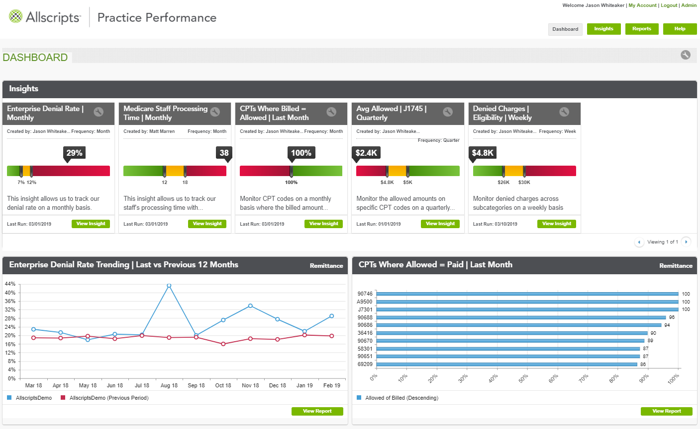
Underpayment analysis
Identify revenue opportunities
CPT Code | CPT Description | Payer | Total Count | Avg Chg | Avg Chg per U | Avg Allowed | Payer Fee Schedule | $ Variation per U
99202 | Office/outpatient Visit, New | Aetna | 1 | $174.00 | $174.00 | $141.10 | $324.75 | ($183.65)
99202 | Office/outpatient Visit, New | Blue Cross of California | 12 | $270.67 | $270.67 | $148.33 | $312.10 | ($163.77)
99202 | Office/outpatient Visit, New | Blue Shield | 1 | $174.00 | $174.00 | $80.26 | $271.26 | ($193.00)
Notes:
Load your payer contracted rates in your PM system so you can compare what you got paid to what you should have been paid. MGMA estimates that payers are underpaying anywhere from 7% to 11%. If you don’t know how to load contracts in your PM system, reach out to your software vendor for instruction.
At a minimum, you should be reviewing your top 25 CPT codes every quarter to see if you’re getting paid properly.

Slide 12
Coders
stakeholders
KPIs & RESPONSIBILITIES
Work coding denials within two days of denial date
Management
Providers
Maintain coding denials at less than 5% of charges
Ensure coding edits are maximized
Front-office Staff
Billing Staff
Follow LCD and NCD guidelines
Stop the bleed and provide coding education to providers
Coders
Notes:
NCDs (National Coverage Determinations) and LCDs (Local Coverage Determinations) are decisions by Medicare and their administrative contractors that provide coverage information and determine whether services are reasonable and necessary on certain services offered by participating providers.

Slide 13
Denial summary
Drill into specific denial categories to determine root cause and remedy
Notes:
For those healthcare leaders who reported an increase in denials, the average increase in denials was 17%.
34% said 11% to 20% increase in denials
12% said 21% to 30% increase in denials
The poll was conducted March 16, 2021, with 576 applicable responses.
Some of the top denials were related to: COVID-19 Codes / Telemedicine / Eligibility

Slide 14
The impact of denials
Why it matters
30% of claims submitted for the first time are denied or rejected for various reasons
50–65% of denied claims are never worked due to lack of time or knowledge
90% of denials are preventable
More than 70% of denied claims can be overturned
It costs around $25 to appeal a claim
Example:
 | Monthly
1. Estimated Denied Revenue (16%) | $90,057.60
2. Recovered Reimbursement (70%) | $63,040.32
3. Estimated Cost Impact ($25) | $24,000.00
4. Estimated Net Denial Impact (1–2)+3 | $51,017.28
Annualized Impact (4*12) | $612,207.36
Avg/Claims per Month | 6,000
Denial Rate | 16%
Revenue/Claim | $93.81
Denied Claims | 960

Slide 15
Front Office Staff
stakeholders
KPIs & RESPONSIBILITIES
Maintain proper appointment status
Management
Providers
Check patient eligibility and benefits
Collect patient balances at time of service
Front-office Staff
Billing Staff
Manage front-office collection performance
Coders

Slide 16
Do you have a proactive approach to managing patient responsibility?
Polling question #3
Yes (Have strong processes upfront to determine and collect from the patient)
No (Still wait until the insurance processes the claim to collect from the patient)
In the process of implementing a proactive approach
Not applicable

Slide 17
Self-pay collection and appointment eligibility
Time of Service Collections
Appointment Start Date: 5/10/2021
Appointment End Date: 5/10/2021
Location | Appt Date | Spec Co Pay | Self Pay Balance | Amount Paid
ABC Medical Group | 16 |  | $148.24 | $200.00
West Side Pulmonary | 3
Main Street | 20 | $180.00 | $949.88 | $365.00
Grand Total | 39 | $180.00 | $1,098.12 | $565.00
Track front-office collection efficiency
Ensure patient eligibility is addressed
Appointments with Inactive Eligibility Responses and MCO
Client: ABC Medical Group | Date Range: 5/14/2021 – 5/14/2021 | Show: Inactive Responses & MCO
Patient Number | Appt Date | Appt Status | Eligibility Status | Scheduling Dept | Scheduling Location | Resource | Carrier Name | Insurance Modified
123456 | 5/14/2021 10:30 AM | Confirmed | Inactive (Red X) | ABC Dept | Location 1 | Dr. Smith | TRUSTED HEALTH PLAN
78374387 | 5/14/2021 9:00 AM | Confirmed | Inactive (Red X) | DEF Dept | Location 2 | Dr. Laura | XXXMEDSTAR DC FAMILY CHOICE
3943847 | 5/14/2021 11:10 AM | Acknowledged | Inactive (Red X) | GHI Dept | Location 3 | Dr. Bates | UHC STUDENT RESOURCES
3984923874 | 5/14/2021 3:30 PM | Scheduled | Inactive (Red X) | JKL Dept | Location 4 | Dr. Levine | CAREFIRST BLUE CHOICE
8435894375 | 5/14/2021 3:15 PM | Confirmed | Inactive (Red X) | MNO Dept | Location 5 | Dr. Cohen | AMERIHEALTH OF DC
8758484 | 5/14/2021 1:45 PM | Scheduled | Inactive (Red X) | PQR Dept | Location 6 | Dr. Loring | CIGNA | 5/12/2021
49754857 | 5/14/2021 8:15 AM | Confirmed | Inactive (Red X) | STU Dept | Location 7 | Dr. Mars | AMERIHEALTH OF DC

Slide 18
Management
stakeholders
KPIs & RESPONSIBILITIES
Establish KPIs
Management
Providers
Review payer contracts
Identify revenue opportunities
Front-office Staff
Billing Staff
Maximize profitability while lowering costs
Provide visibility to all stakeholders of the revenue
Coders
Notes:
Management is responsible for providing the operational framework to establish accountability across departments

Slide 19
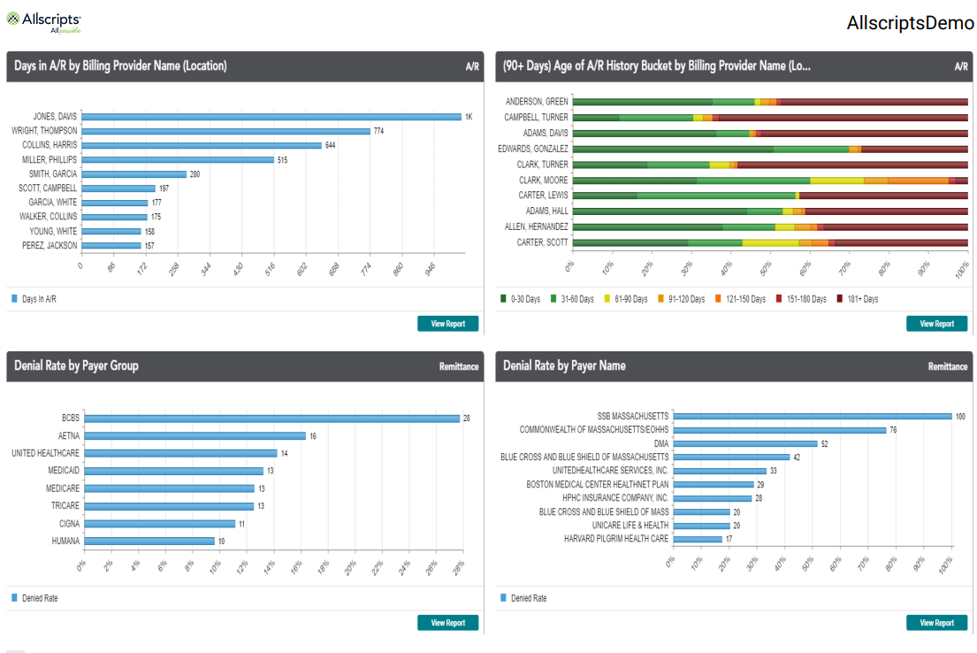
The pulse of your practice at your fingertips
Ensure you can easily spot trends and respond to issues affecting your KPIs

Slide 20
Next steps
Review your payer mix to determine the KPIs to track
Look at trends in seasonality
(e.g., Q1 deductibles, cash flow projection)
Create your own KPIs against MGMA standards
Share the information with all stakeholders
Frequency to benchmark
Agree on the KPIs

Slide 21
Questions?
Email corporatemarketing@allscripts.com

